Slide 1
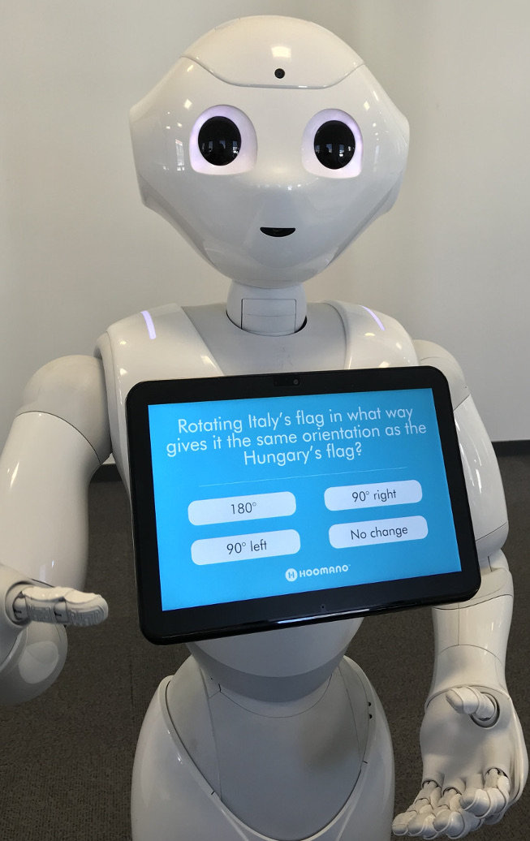
Question Answering
Natural Language Processing (NLP)
SS Team

Slide 2
Table of contents
Applications
Input Output
Model
Demo

Slide 3
1. Applications
Answer the customers’ questions automatically about company, product, recruitment, …
Notes:
VD: SP này có ship về Cà Mau không shop?
VD:

Slide 4
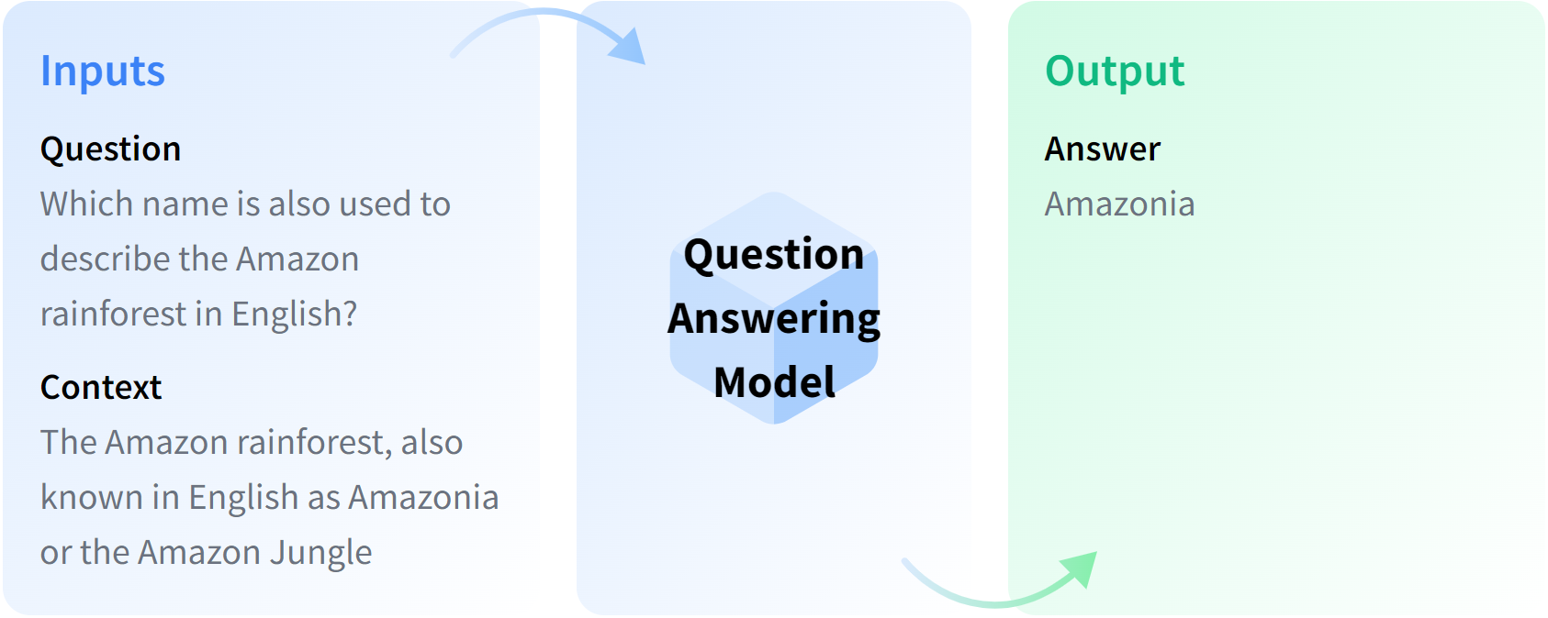
2. Input Output

Slide 5
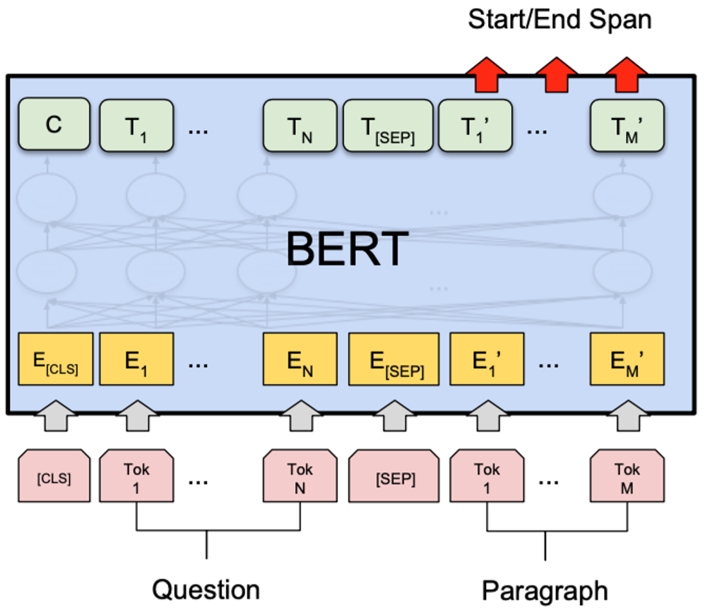
3. Model
Output
Step 3: Softmax
Find start and end positions
Step 2: BERT
Learn context
Step 1: Tokenization
Process input to feed into BERT
Input

Slide 6
3.1 Tokenization
Who was Jim Henson?
CLS (Classification): is added at start of a sequence so _
that it represents the entire sentence
SEP (Separator): is a delimiter token between sentences
Tokenize
[CLS, Who, was, Jim, He, ##nson, ?, SEP]
Mapping
[101, 2627, 1108, 3104, 1124, 15703, 136, 102]
Token Embedding
[vector 1, …, …, …, …, …, …, vector 8]

Slide 7
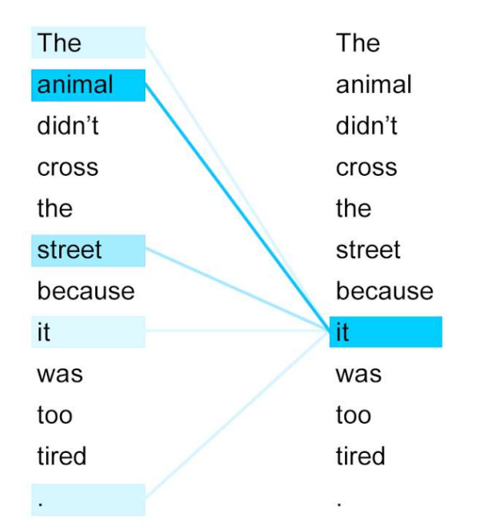
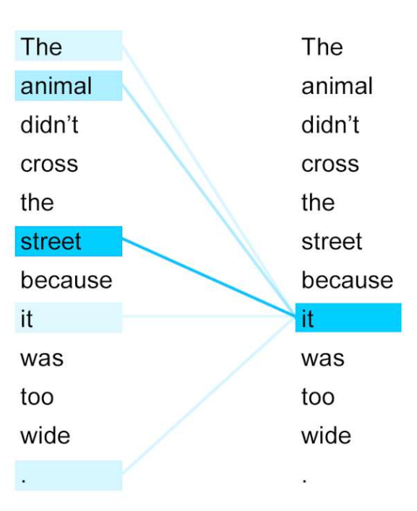
3.2 BERT
Notes:
Khi dự đoán từ còn thiếu trong câu The … didn’t cross the street because it was too tired
Xác suất dự đoán ra từ animal là cao nhất P(animal | …) max
Biểu diễn thông tin 2 chiều

Slide 8
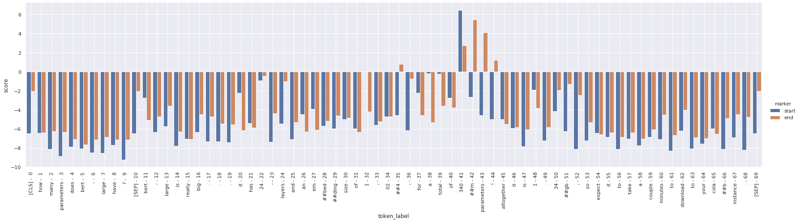
3.3 Softmax

Slide 9
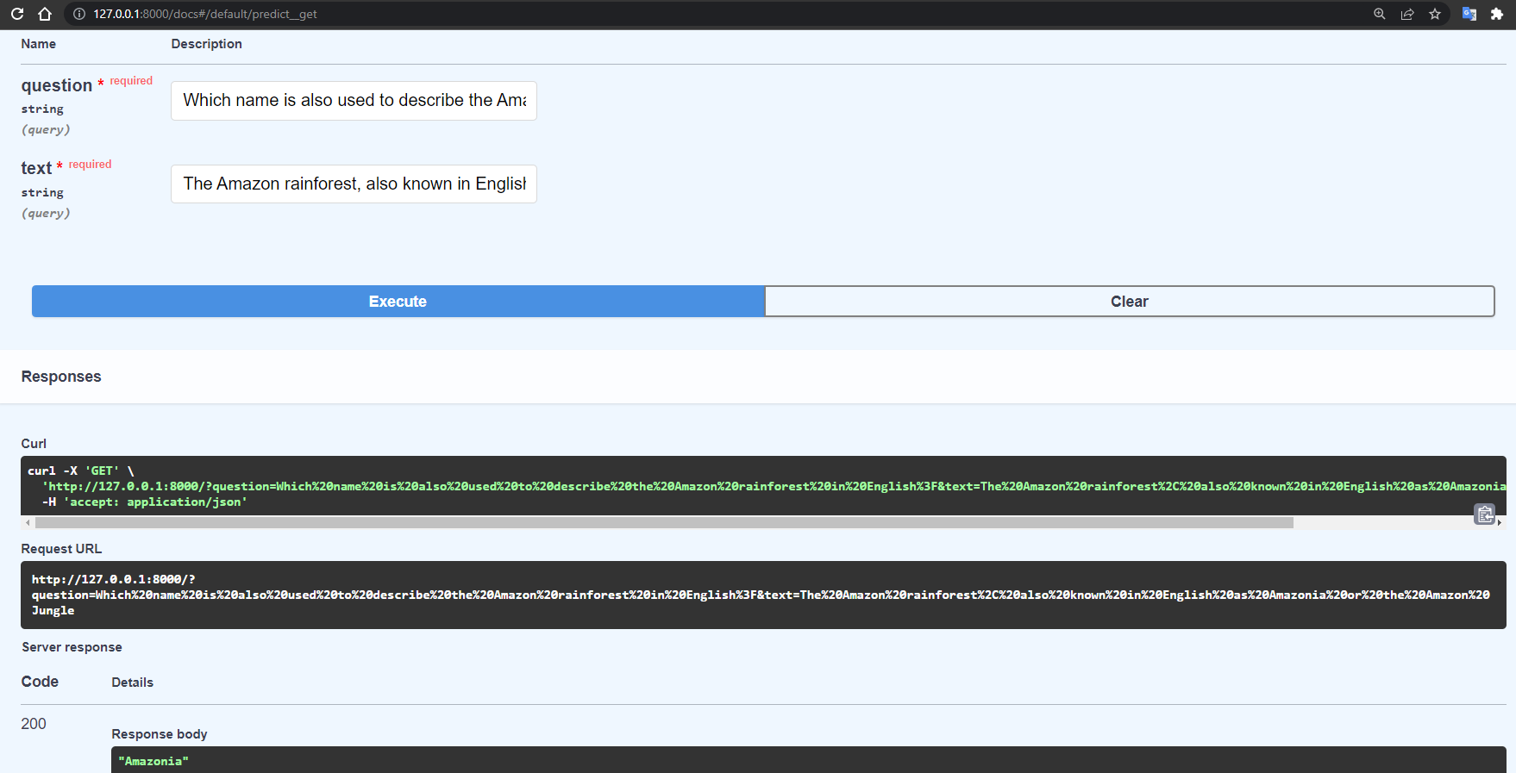
4. Demo
Notes:
512 words khoảng 1 trang A4

Slide 10
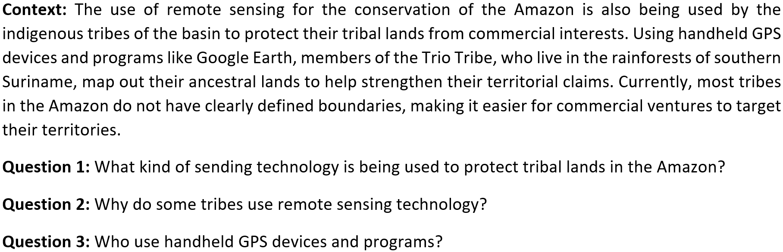
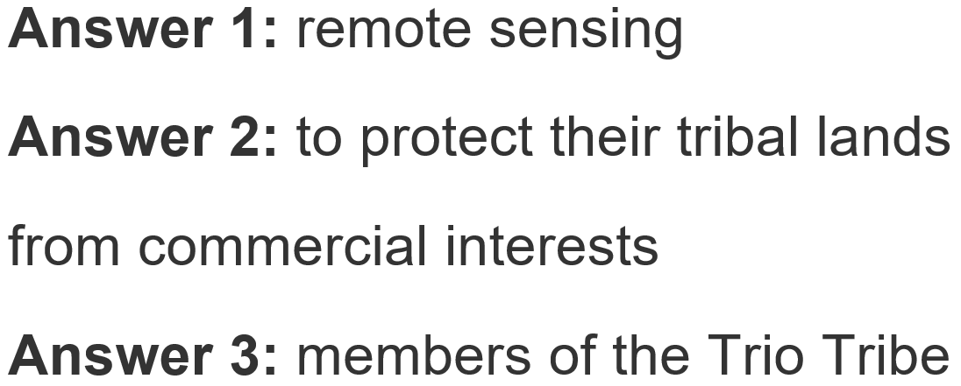
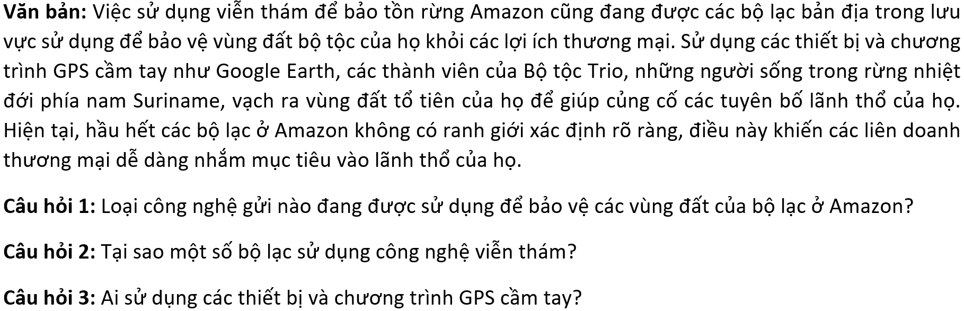
4. Demo

Slide 11
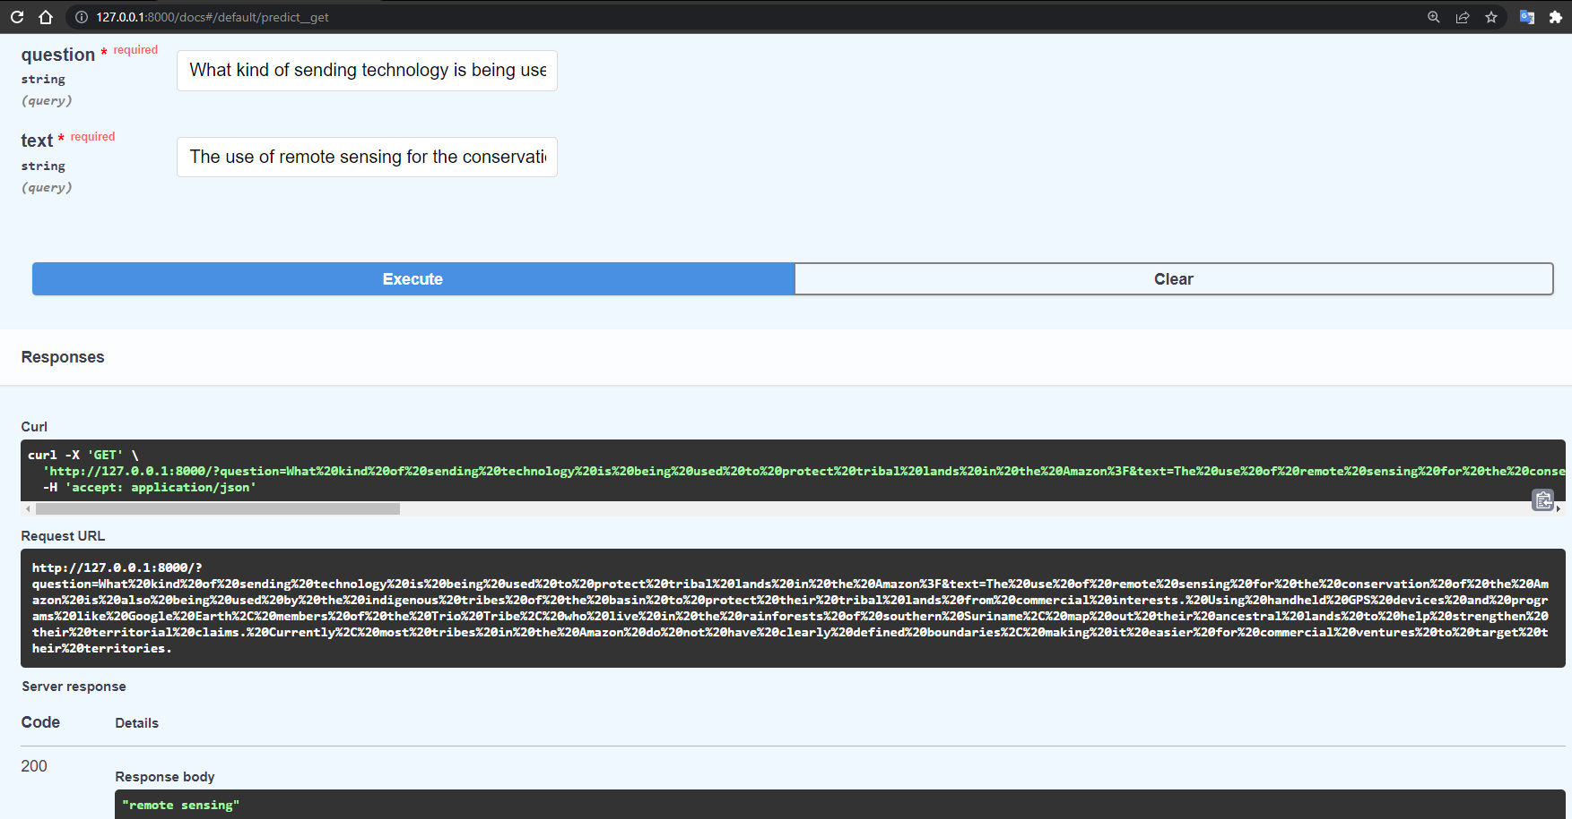
4. Demo

Slide 12
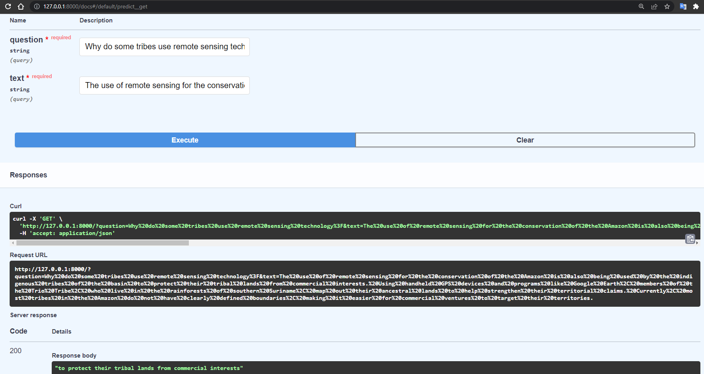
4. Demo

Slide 13
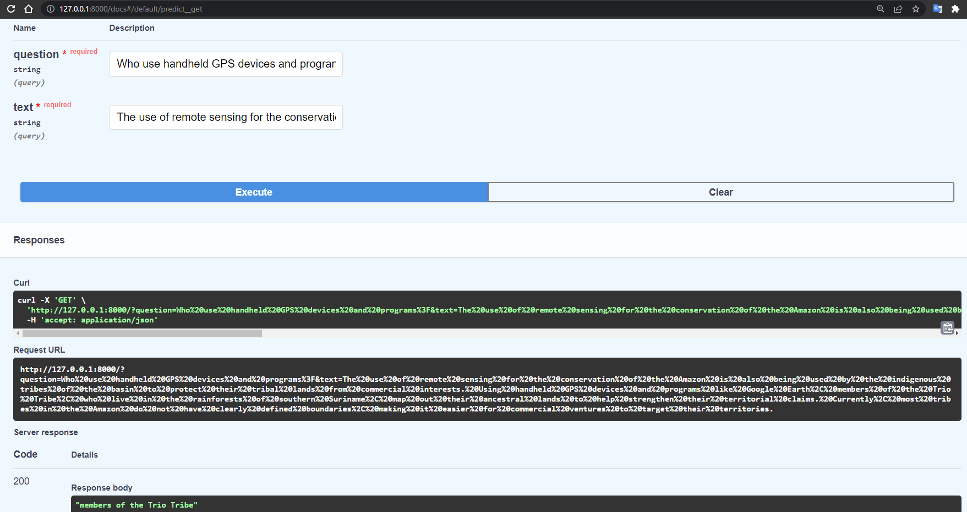
4. Demo

Slide 14
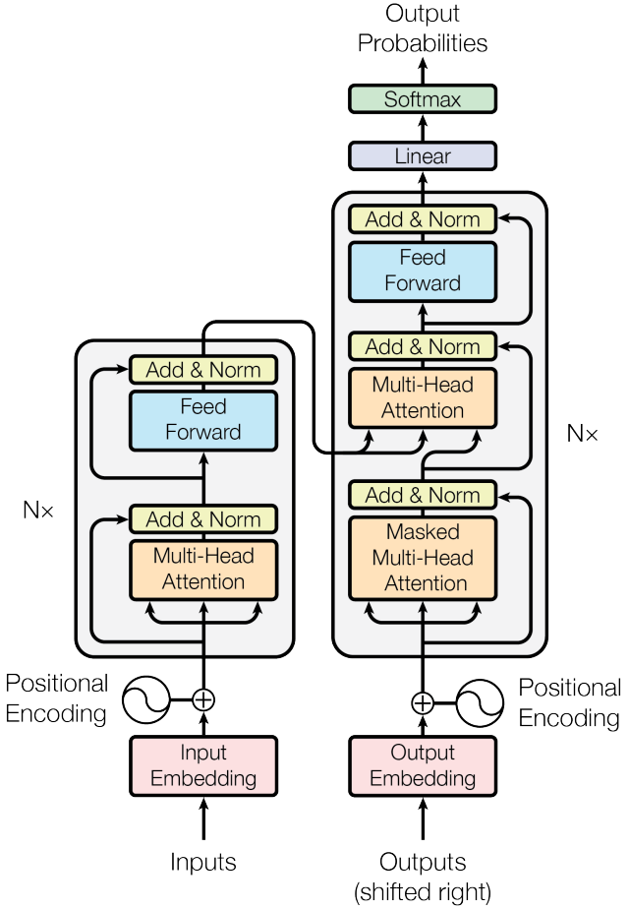
Appendix 1: Transformer

Slide 15
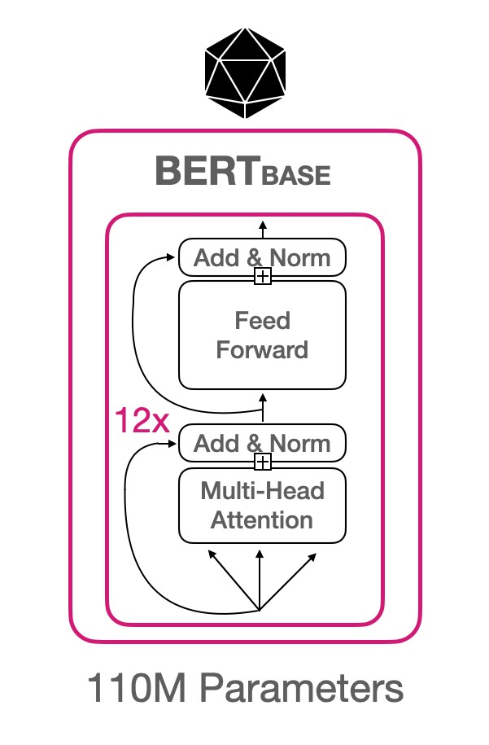
Appendix 2: BERT

